Slide 1
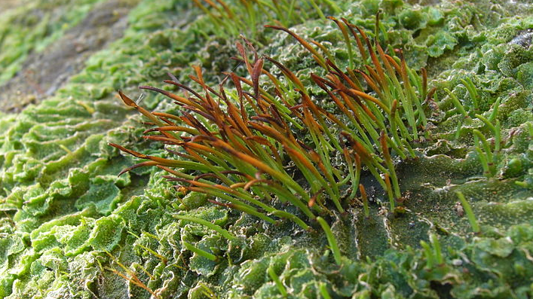
Reach for the Sky
Jason Hollinger / CC BY (https://creativecommons.org/licenses/by/2.0)

Slide 2
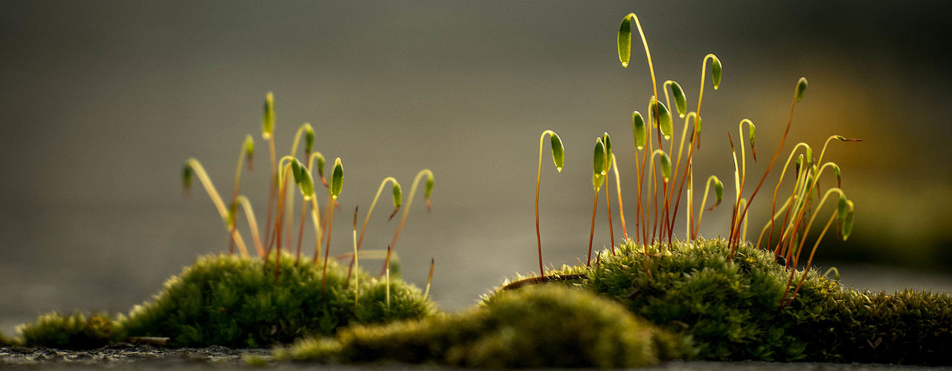
The problem with being a bryophyte….
Poor ability to capture and retain water
So… confined to damp places
But… can spread using spores
Can survive total desiccation (resurrection plant)
Poor water transport
Limited uptake of nutrients (maybe ombrotrophic)
Limited height – need to be near surface
By gwenole camus from Cournon d'auvergne, France - P1030792, CC BY-SA 2.0, https://commons.wikimedia.org/w/index.php?curid=43080830

Slide 3
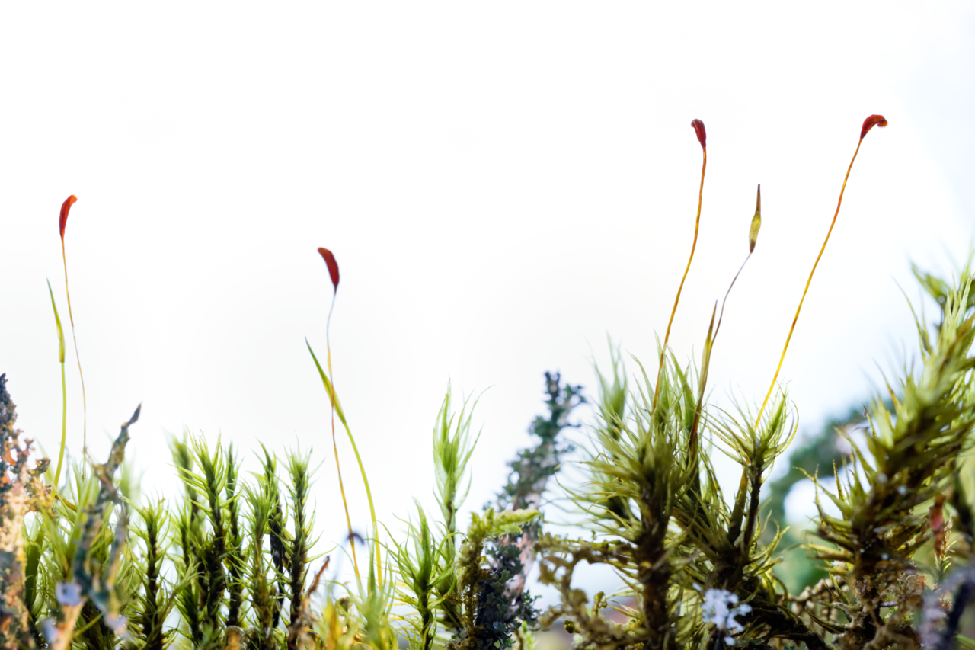
War of the Generations…
Sporophyte 2n
By Oscar Furbacken - Own work, CC BY-SA 4.0, https://commons.wikimedia.org/w/index.php?curid=59930654
Gametophyte - n
Sporophyte is 50% foreign to “mother”
Sporophyte is +/- heterotrophic
Is sporophyte “parasitic” on gametophyte?

Slide 4
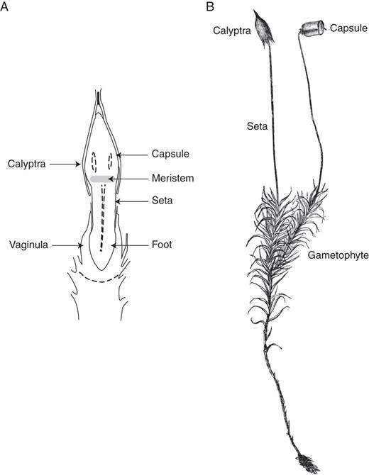
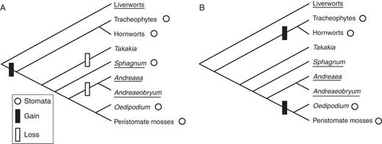
Moss and hornwort sporophytes have stomata and vascular tissue
Models for evolution of stomata in Sporophytes
(Sphagnum has pseudostomata)
Sporophyte and associated gametophytic structures from Phascum cuspidatum
Vascular tissue: hollow tubes carrying water
Stomata: pores in tissue surface
Is transpiration a way of “sucking” nutrients from gametophyte?
https://academic.oup.com/aob/article/111/3/337/146966/Filial-mistletoes-the-functional-morphology-of

Slide 6
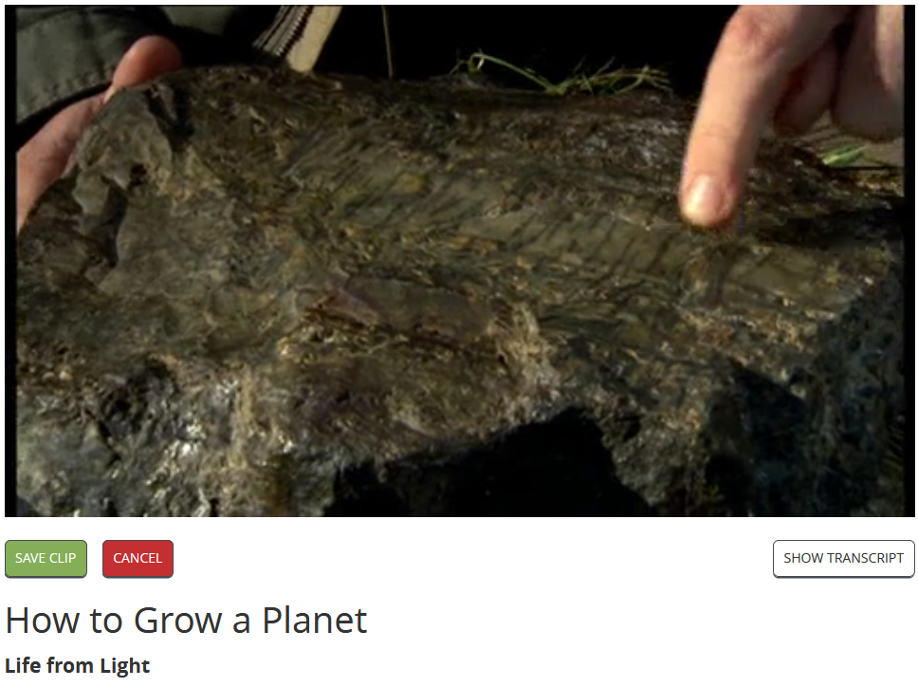
https://learningonscreen.ac.uk/ondemand/index.php/clip/101325 (3:20)

Slide 8
The Rhynie Chert
Jason Hollinger / CC BY (https://creativecommons.org/licenses/by/2.0)

Slide 9
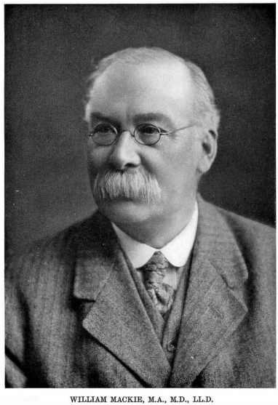
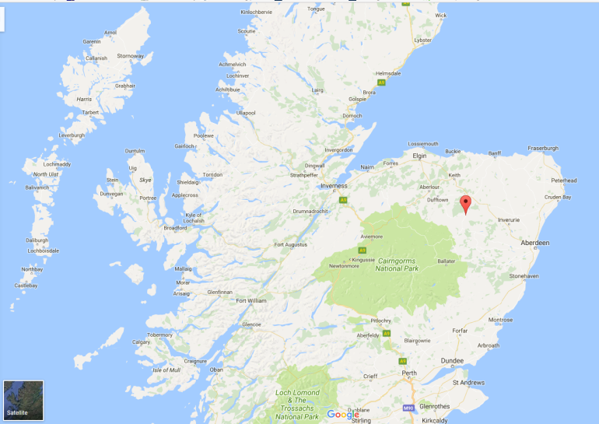
William Mackie – Full time physician, amateur geologist
“Mackie was not only a skilled microscopist and chemist; he was an enthusiastic and competent field observer, and his keen eye detected the plant-bearing cherts of Rhynie in a drystone dyke by the roadside during one of his frequent excursions to Central Aberdeenshire.”
Results presented to Edinburgh Geological Society 1912
http://trned.lyellcollection.org/content/transed/13/1/106.full.pdf

Slide 10
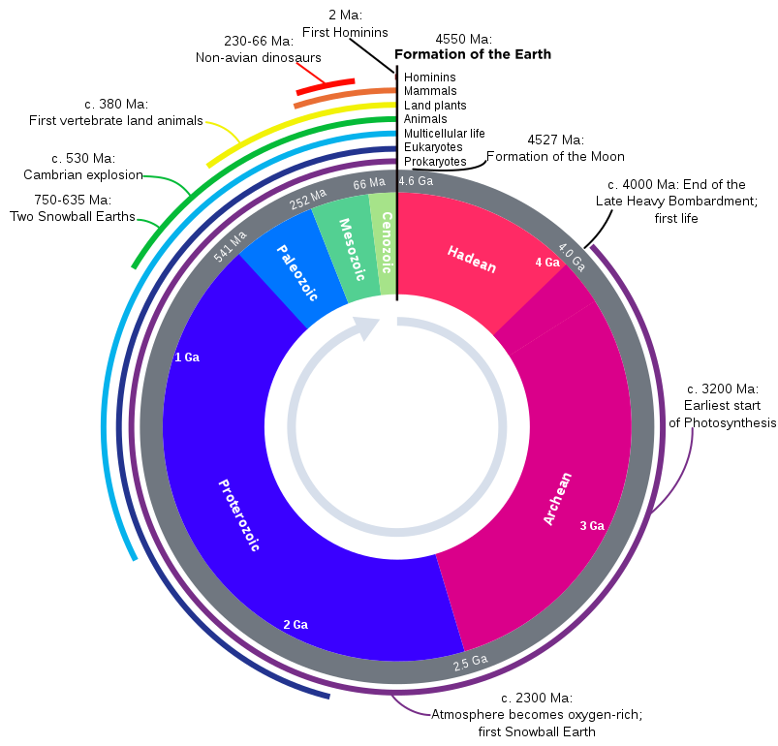
The Rhynie Chert - ~410 MYa
Read more about this: https://www.cambridge.org/core/journals/geological-magazine/article/an-introduction-to-the-rhynie-chert/8F6F361EF41FED11FA97C3448DE09458

Slide 11
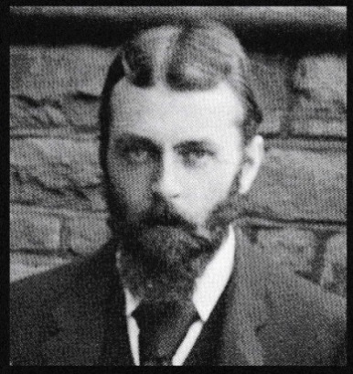
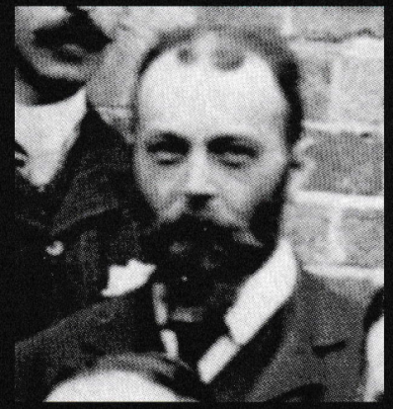
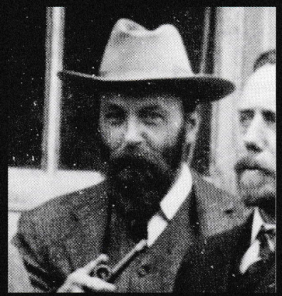
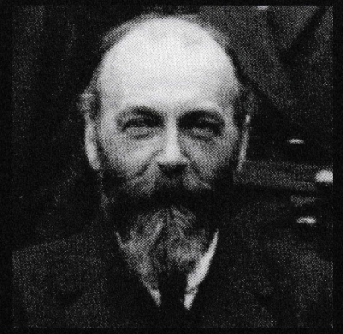
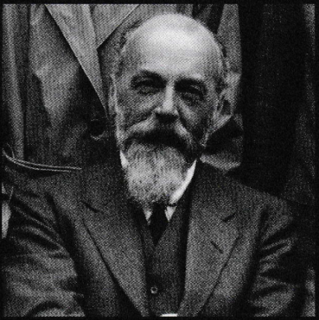
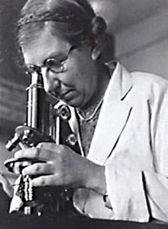
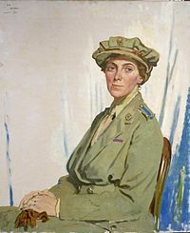
Prof. William H. Lang,
1st Barker Professor of Cryptogamic Botany,
University of Manchester
1898
1904
1908
1921
1930
The Glasgow Years
The Manchester Years
Cooksonia sp.
Asteroxylon mackiei
Rhynia gwynne-vaughanii
Helen Gwynne Vaughan
Isabel Cookson

Slide 12
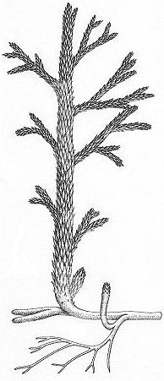
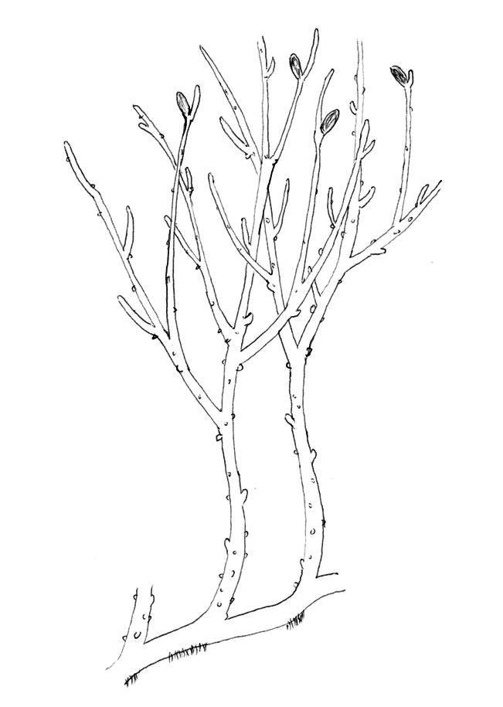
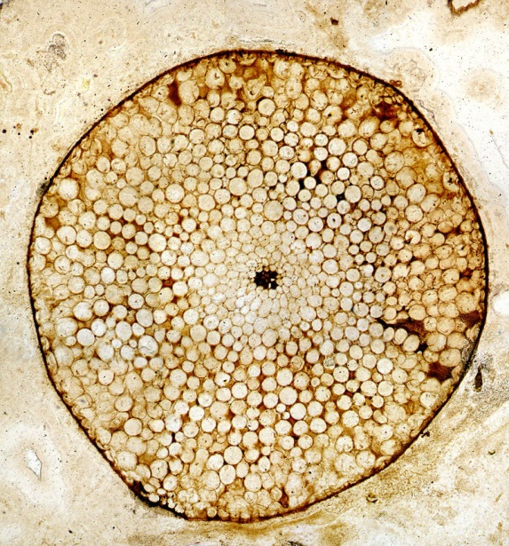
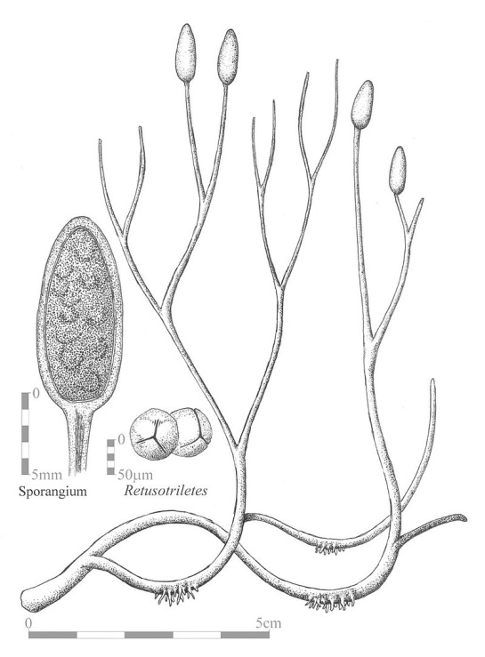
Rhynie Flora – 7 “plant” genera
Rhynia gwynne-vaughanii
Vascular Bundle
By Plantsurfer - Own work, CC BY-SA 2.0 uk, https://commons.wikimedia.org/w/index.php?curid=3823922
By Griensteidl - CC BY-SA 3.0, https://commons.wikimedia.org/w/index.php?curid=3495934
Gametophytes and sporophytes similar dominance
Asteroxylon mackiei
https://commons.wikimedia.org/w/index.php?curid=9445044
Early member of Lycopodiophyta –
Clubmosses, quillworts, firmosses
Aglaophyton major
Mycorrhizal associations
CC BY-SA 4.0, https://commons.wikimedia.org/w/index.php?curid=36979632

Slide 13
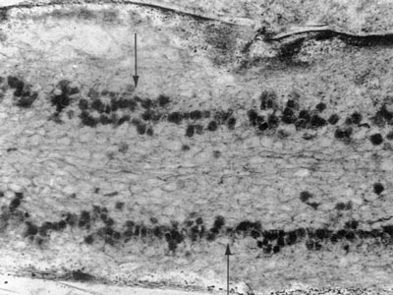
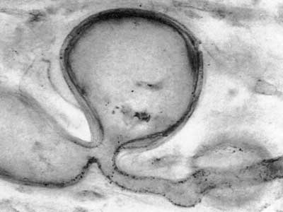
Fungal Associations
Fungus-like structures associated with Aglophyton
Mycorrhiza: fungus closely associated with plant roots
Symbiotic relationship – fungus gives nutrients – plant gives sugars
Very important for plant growth – allows nutrient capture over large areas

Slide 14
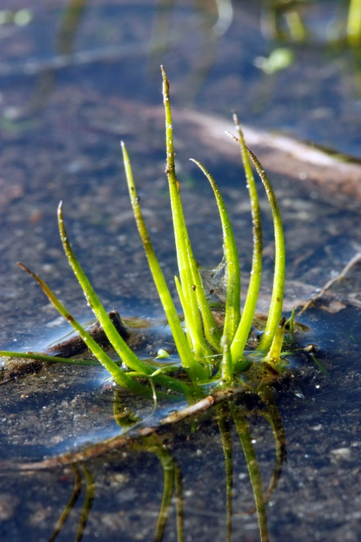
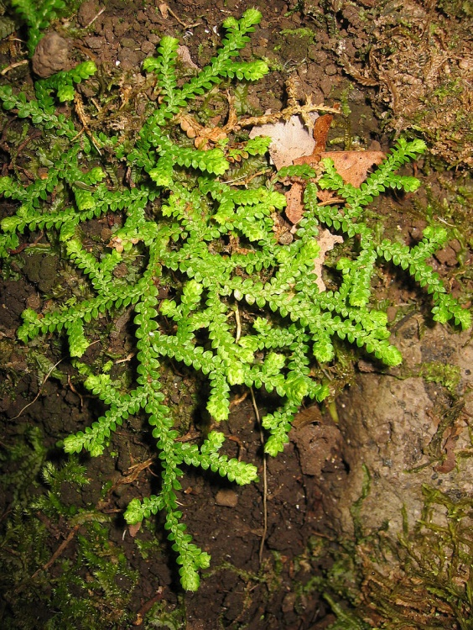
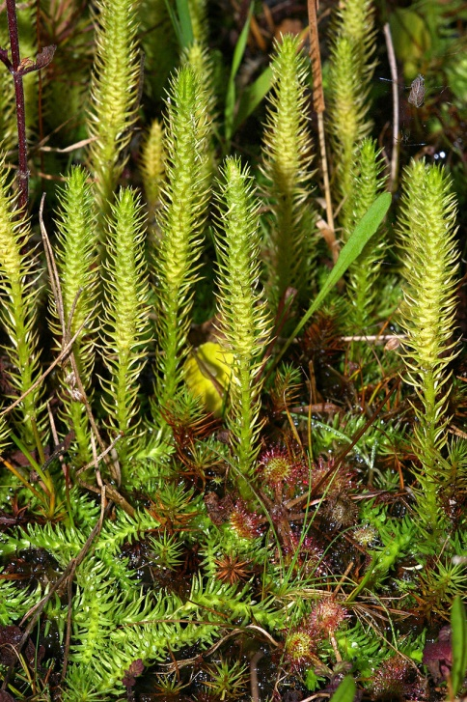
Lycopodiophyta
Isoetes melanospora
Selaginella denticulata
Lycopodiella inundata
By AHR12 (Own work) https://commons.wikimedia.org/wiki/File%3ACloseup_of_Black-spored_Quillwort_(Isoetes_melanospora).jpg
By Tigerente - Own work, CC BY-SA 3.0, https://commons.wikimedia.org/w/index.php?curid=4266299
By Christian Fischer, CC BY-SA 3.0, https://commons.wikimedia.org/w/index.php?curid=4925336
Quillwort
Clubmoss – n.b. also NOT a moss
Spikemoss – n.b. NOT a moss
Reproduce by Spores
Alternation of generations
Sporophyte dominant and photosynthetic
Vascular system - Xylem
Simple “leaves” - microphylls

Slide 15
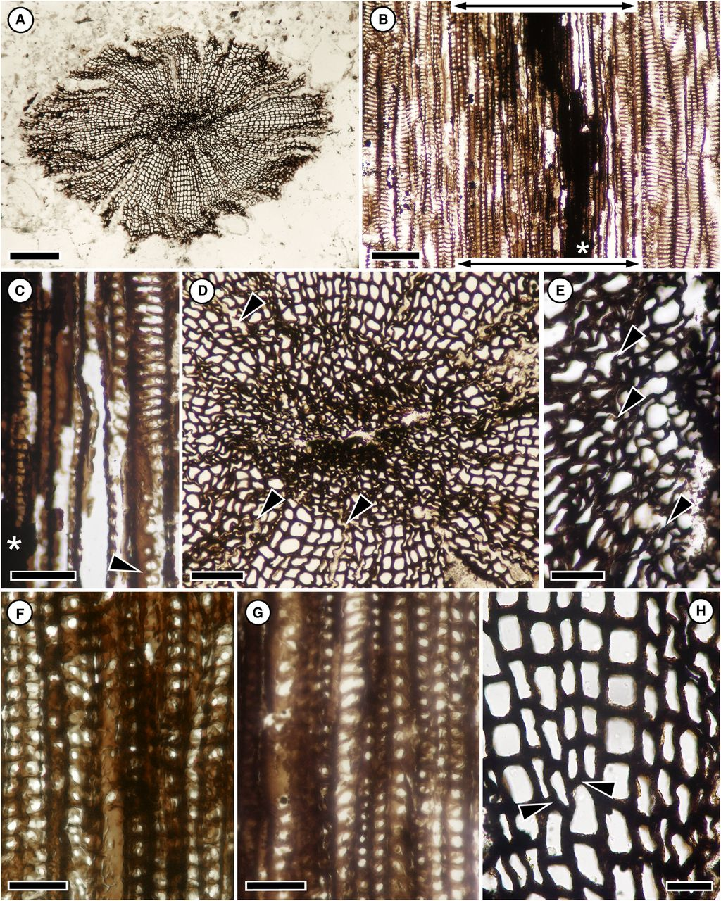
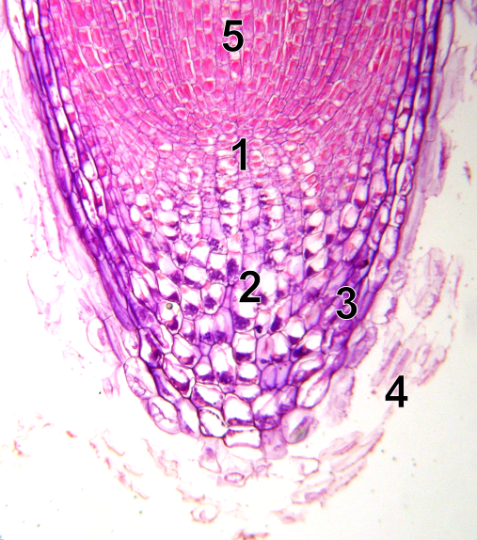
Secondary Growth
Primary growth – cell division at a tip (apical meristem) resulting in elongation of tissues
Franhueberia gerriennei
By SuperManu - Own work, based on File:Root tip.JPG by Clematis, CC BY-SA 2.5, https://commons.wikimedia.org/w/index.php?curid=3097034
Secondary growth – cell division at cambia (lateral meristem) results in structures becoming thicker
Laurel A. Hoffman, and Alexandru M. F. Tomescu Am. J. Bot. 2013;100:754-763
Early fossil example of secondary thickening
Lycophytes evolved thick stems with LIGNIN

Slide 17
The Carboniferous
Jason Hollinger / CC BY (https://creativecommons.org/licenses/by/2.0)

Slide 18
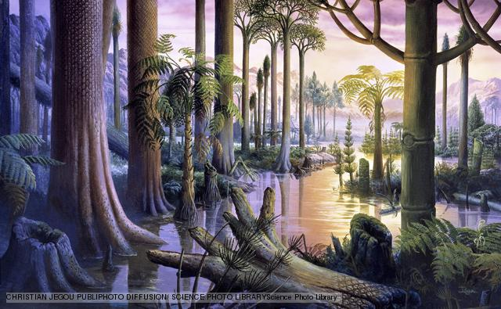
The Carboniferous
~360 – 300 million year ago
Formation of PANGAEA
Extensive tropical lycopod forests
e.g. Lepidodendron sp.

Slide 19
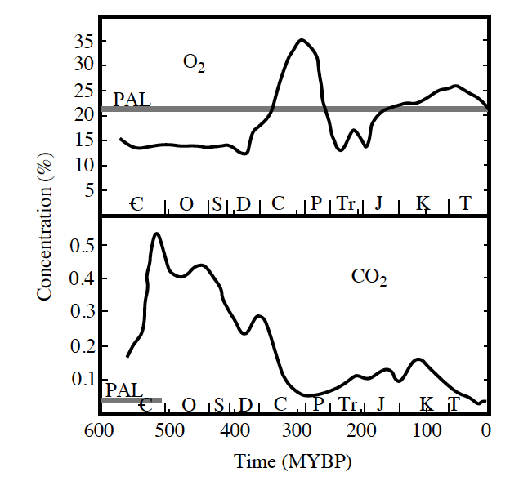
Changing Atmosphere
Carboniferous Rainforest Collapse-
Mass extinction event
Falling CO₂ = plant starvation?!

Slide 20
The Megaphylls
Jason Hollinger / CC BY (https://creativecommons.org/licenses/by/2.0)

Slide 21
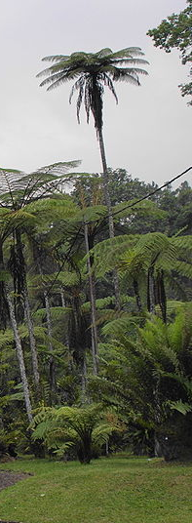
The Rise of the Megaphylls
Megaphyll = “large leaf” (c.f. microphylls)
Branched veins – allows for wider flatter surface
Better light capture – more photosynthesis but hotter…
Low CO₂ = need more stomata
More stomata = cooler leaves but more water needed
Falling CO₂ drove the evolution of megaphylls
FERNS
https://academic.oup.com/aob/article/96/3/345/209547/Leaf-Evolution-Gases-Genes-and-Geochemistry

Slide 22
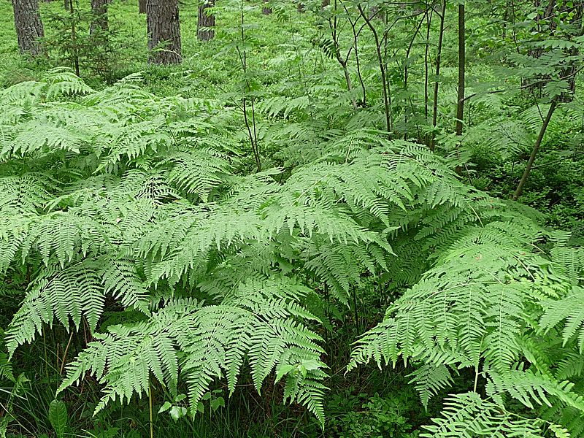
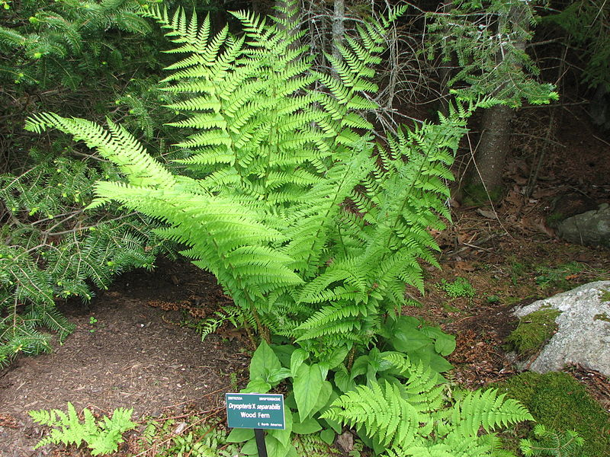
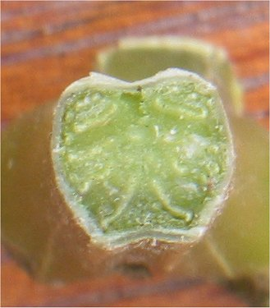
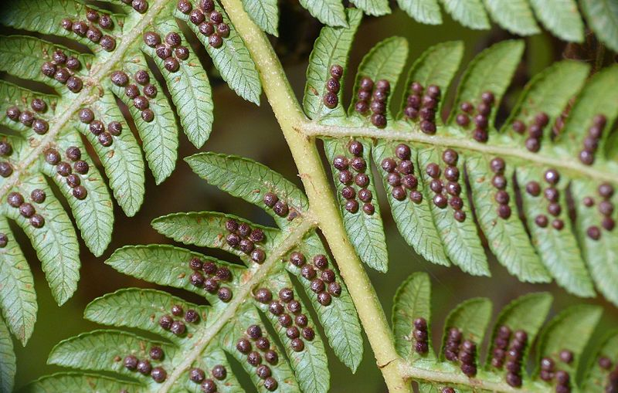
Pteridophyta* – the ferns
Rhizomes
Shuttlecock
By Konrad Lackerbeck - Own work, CC0, https://commons.wikimedia.org/w/index.php?curid=53337431
By Choess - Own work, CC BY-SA 3.0, https://commons.wikimedia.org/w/index.php?curid=21911966
Vascular tissue
Sori
By L. Shyamal - Own work, CC BY-SA 3.0, https://commons.wikimedia.org/w/index.php?curid=47003481
By Rasbak - Own work, CC BY-SA 3.0, https://commons.wikimedia.org/w/index.php?curid=217092
*Or maybe Polypodiidae – see https://en.wikipedia.org/wiki/Talk:Pteridopsida

Slide 23
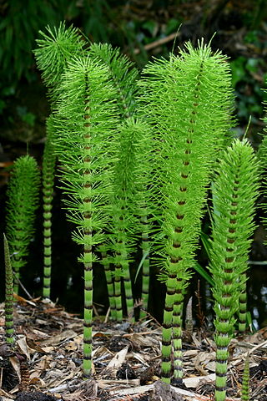
The Horsetails
Equisetum telmateia
Family: Equisetaceae
Genus: Equisetum
Common name: horsetails
(Only extant Genus in this family)
By Rror - Own work, CC BY-SA 3.0, https://commons.wikimedia.org/w/index.php?curid=4077821

Slide 24
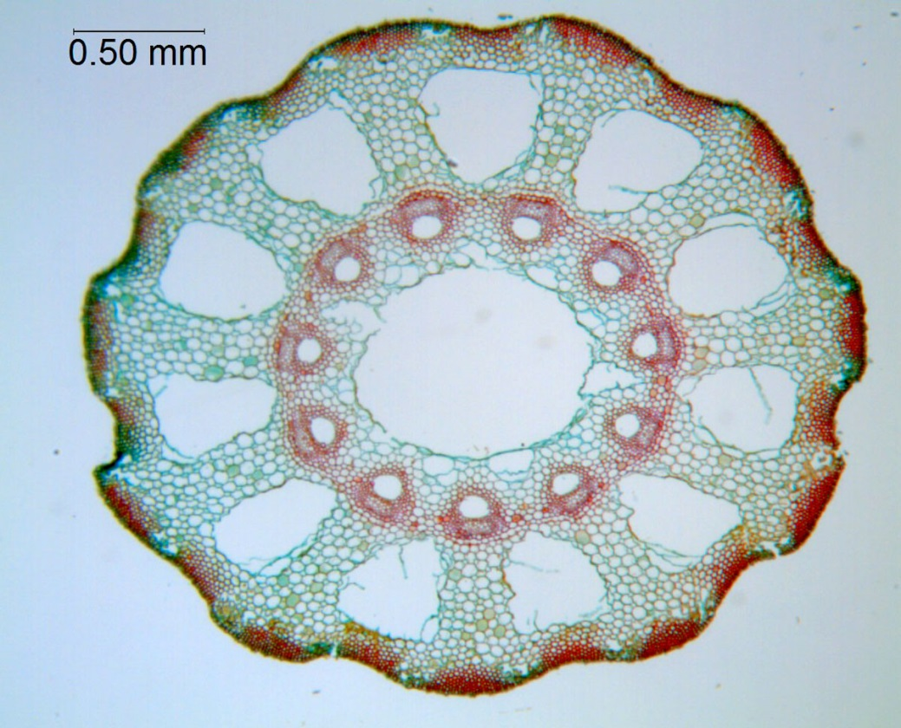
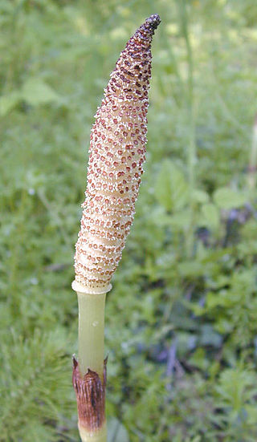
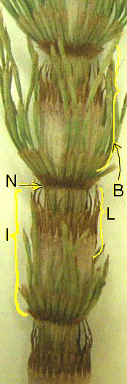
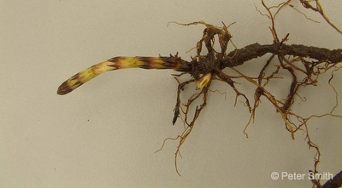
Horsetail Innovations
Ring of xylem:
Better water transport;
Stronger
Better branching
Extensive roots (rhizomes):
Better water uptake;
Vegetative spread;
Deciduous
Reproductive structures:
Strobili – cone like structure producing spores
PhytoImages.siu.edu
By Marshman at English Wikipedia / Eric Guinther CC BY-SA 3.0, https://commons.wikimedia.org/w/index.php?curid=10541277
By Menchi at the English language Wikipedia, CC BY-SA 3.0, https://commons.wikimedia.org/w/index.php?curid=11354496
http://www.weedinfo.ca/en/weed-index/view/id/EQUAR

Slide 25
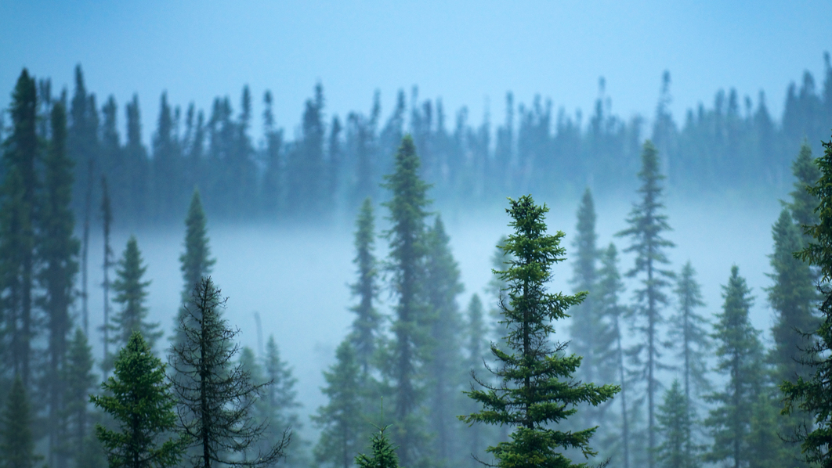
Norwegian Wood

Slide 26
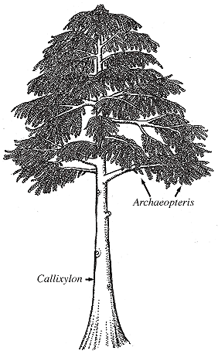
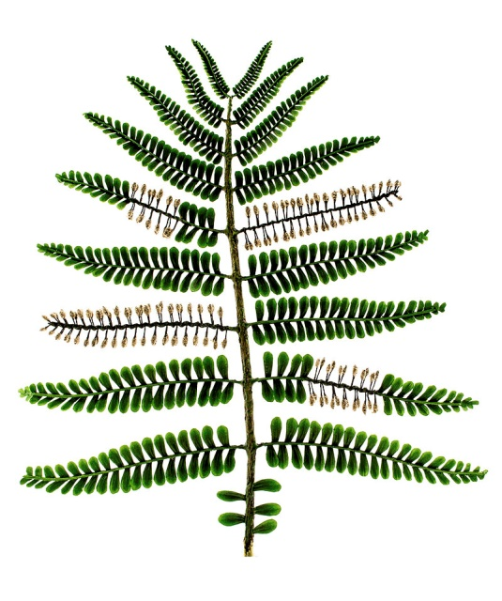
The Progymnosperms
Archaeopteris†
Appeared Upper Devonian
Fern-like fronds
  Reproduces by spores –gametophytes
      So, a big fern?!
By Matteo De Stefano/MUSE, CC BY-SA 3.0, https://commons.wikimedia.org/w/index.php?curid=48059402
But…
  Has ring of vascular cambium
    i.e. secondary thickening*
    Wood!
It’s a tree!
http://www.ucmp.berkeley.edu/IB181/VPL/Osp/Osp2.html
† n.b. NOT Archaeopteryx
*unlike tree ferns (Dicksonia)

Slide 27
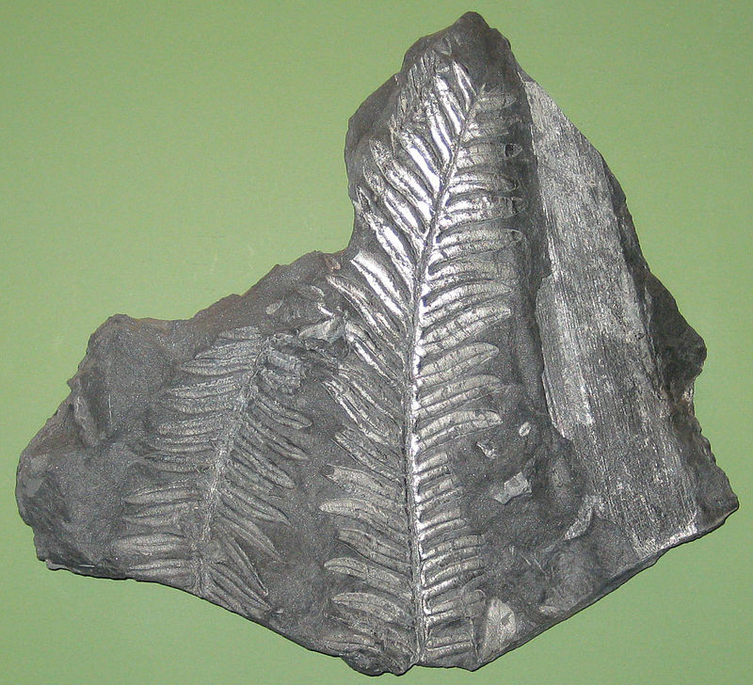
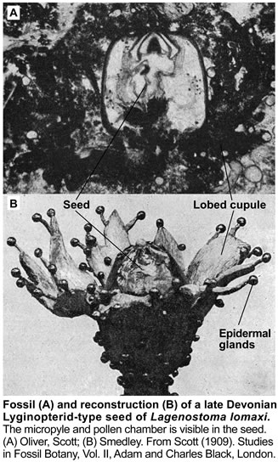
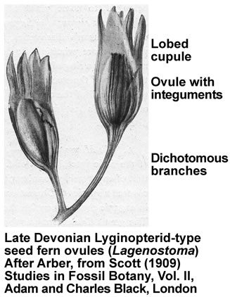
Pteridospermatophyta – the “seed ferns”
Evolved late Devonian
Fern-like foliage…
By Jstuby at English Wikipedia - Transferred from en.wikipedia to Commons by Innotata using CommonsHelper., Public Domain, https://commons.wikimedia.org/w/index.php?curid=15115352
…but produces seeds
http://www.seedbiology.de/evolution.asp#fossils

Slide 28
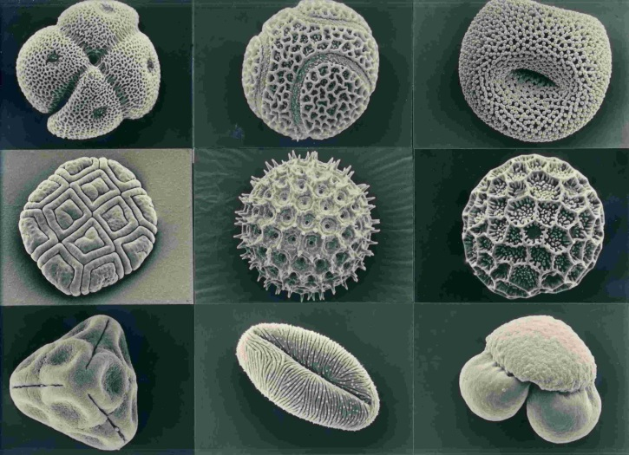
Pteridospermatophyta – key innovations
No free living gametophyte
Female gametophyte (archegonium) retained by parent
Male gametophyte produced by microsporangium – released as POLLEN
Pollen carries sperm to female – does not require water

Slide 29
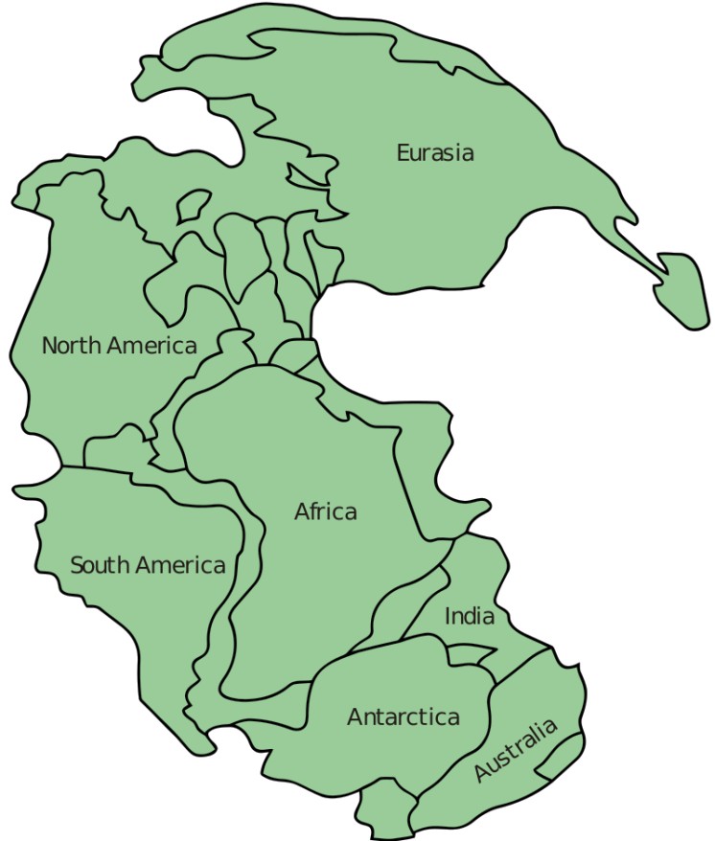
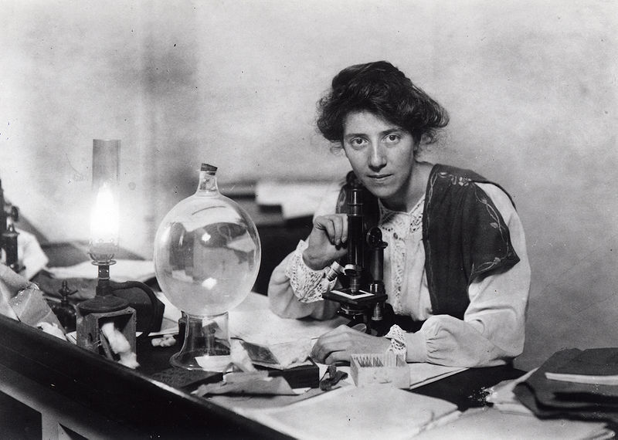
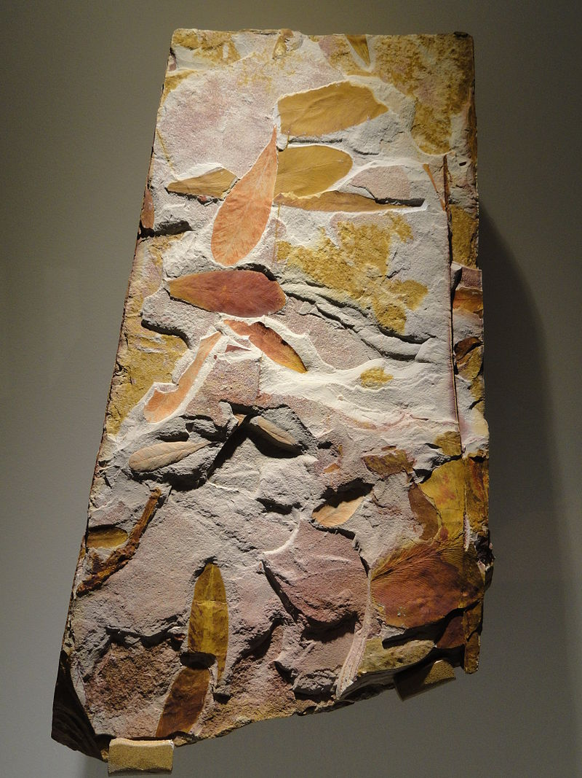
The Fall of the Lycopods
Seed ferns evolved in late Devonian
Lycopods dominated in Carboniferous
If seeds are so good why did lycopods last so long?
Plate tectonics?
Carboniferous – warm, wet, tropical
Permian – formation of Pangea
Ice Ages
Drying climate (espec. Continental)
New climate not good for gametophytes
Lycopods replaced by GYMNOSPERMS
Glossopteris
By en:User:Kieff - File:Pangaea continents.png, CC BY-SA 3.0, https://commons.wikimedia.org/w/index.php?curid=8161694
https://en.wikipedia.org/wiki/Carboniferous_rainforest_collapse

Slide 31
Rise of the Gymnosperms

Slide 32
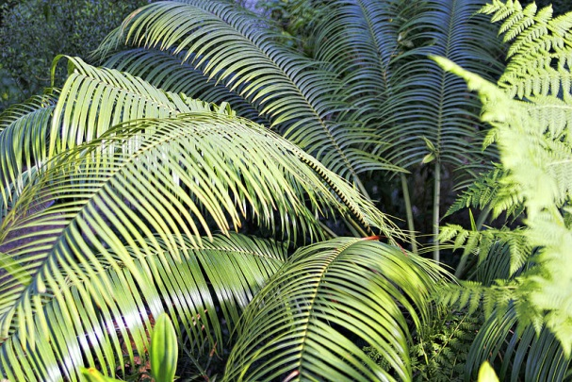




The Permian: Rise of the Gymnosperms
Naked
seed
Appeared ~320 Mya (late carboniferous)
Evolved from progymnosperms
Divergence probably resulted from genome duplication
Combined WOOD and SEEDS

Slide 33

Oh them cones, them cones, them dry cones…
Male and female cones
Wind Pollination
Seed matures in cone - nurture
Derivative work, CC BY-SA 3.0, https://commons.wikimedia.org/w/index.php?curid=37822866
Controlled seed release

Slide 34

So, what is a seed?
Nucellus – from mother
Feeds the embryo
Embryo = developing new generation
Parental Nurture
(c.f. mammals)

Slide 35
A quick phyologeny…
Progymnosperms
?
Pteridospermatophyta
Gymnosperms
Cycads
Flowering plants
Ginkgos
Conifers
Gnetophytes
Flowering plants
n.b. this is controversial – see Wikipedia

Slide 37

Appearance of the Dinosaurs (240 Mya)
https://learningonscreen.ac.uk/ondemand/index.php/clip/102228 (4 mins)

Slide 39
GymnospermDiversity

Slide 40



Cycadophyta – the cycads
Evolved 280 Mya (early Permian)
First dominant gymnosperms – still extant
Dioecious – males and females
Drought tolerant
Simple structure
Slow wood production
Female Cone
Wood’s cycad
Male Cones
By Muhammad Mahdi Karim - Own work, GFDL 1.2, https://commons.wikimedia.org/w/index.php?curid=5769082
CC BY-SA 3.0, https://commons.wikimedia.org/w/index.php?curid=134793
By Purves, M., CC BY-SA 3.0, https://commons.wikimedia.org/w/index.php?curid=17974140

Slide 41




Ginkgophyta
Single extant species – Ginkgo biloba
Evolved 270 Mya
Dioecious
Deciduous
Seed wall fleshy – like a fruit
Branching
By Famartin - Own work, CC BY-SA 4.0, https://commons.wikimedia.org/w/index.php?curid=36997399
By James Field (Jame) - Own work, CC BY-SA 3.0, https://commons.wikimedia.org/w/index.php?curid=3707381
Curtis Clark, CC BY-SA 2.5, https://commons.wikimedia.org/w/index.php?curid=1048185
By Joe Schneid, Louisville, Kentucky - Own work, CC BY-SA 3.0, https://commons.wikimedia.org/w/index.php?curid=9488972

Slide 42


Pinophyta – the conifers
Evolved ~300 Mya
Single extant order - Pinales
Often monoiecous
– male and female cones on same tree
Long-lived – Bristlecone pine >5000 years old
Woody branched trees (and shrubs)
Grow FAST and BIG
By Dcrjsr - Own work, CC BY-SA 3.0, https://commons.wikimedia.org/w/index.php?curid=11040152
By Menchi at the English language Wikipedia, CC BY-SA 3.0, https://commons.wikimedia.org/w/index.php?curid=192534

Slide 43





Conifers today
Stress tolerant…
…so grow in extreme locations…
Drought tolerant
Fire tolerant
Boreal (arctic) forest
Mediterranean forest
Alpine forest

Slide 44




Conifers today
Commercially important
Soft wood
Juniper “berries”
…but not globally dominant?

Slide 45



Gnetophyta
Three Families – three genera
Gnetum gnemon
Welwitschia mirabilis
By Kembangraps - Own work, CC BY-SA 3.0, https://commons.wikimedia.org/w/index.php?curid=4085486
By Muriel Gottrop from pt, CC BY-SA 3.0, https://commons.wikimedia.org/w/index.php?curid=2134562
By Le.Loup.Gris - Own work, CC BY-SA 3.0, https://commons.wikimedia.org/w/index.php?curid=15764815
Ephedera distachya
Very different to one another
But share features with flowering plants

